Slide 1
ML1: Introduction to Machine Learning for Everybody SE GP G QPI QM P

Slide 2

Training Objective
By the end of this course, you will …
Have a better understanding of what machine learning is all about
Understand some basic principals of machine learning
Have made first experiences with running machine learning algorithms yourself
Discuss application opportunities of Machine Learning in our business
Tailoring Knowledge to your needs in our Energy business
This training is an experiment
New teaching approach targeting “everybody”
New teaching over Circuit/ pure recordings
We are using EnergyAI, Python and Jupiter Notebooks in this course. We explain more about these in our Data Science trainings. https://wse10.siemens-energy.com/content/P0002338/SitePages/Data%20Science%20Training%20and%20Multiplier%20Networking.aspx
However, we don’t want to make them a prerequisite, so that everybody can attend.

Slide 3

How this Training Works
Experiment, we are all learning
2x10 Min Break
Recording: high demand, few training seats
Based on interaction
Discussions, Exercises + Debriefs
Harder in Circuit
If I should not call on you, please tell us now

Slide 4
Please Give Us Feedback!
Feedback is very important for us. This course is free, but we need to know if this is beneficial for you.
Based on your feedback, we will continue to offer this, develop additional courses – or not.
Please visit at the end of this course the following website: https://forms.office.com/Pages/ResponsePage.aspx?id=PqlLJW8f80iQ5uJ2ZmS0d-5LdjYRShZEhN3YmsD7St9UMFZZTFFVQjFSUUxTMzhQNTM3S1hSM0ExVS4u

Slide 5

Agenda
Introduction
What Is Machine Learning?
Decision Tree Algorithms
Limits of Machine Learning
Neural Networks
Summary: Definitions and Difference between Important Approaches
Application of Machine Learning in Our Business

Slide 6

We are Using EnergyAI as a Tool to Run Machine Learning Algorithms
Please register on EnergyAI before starting the training:(https://energyai.siemens.cloud/)
Request access to “Analyse”
You will find the files in EnergyAI in the folder shared>users>kay.toepfer@siemens.com>Data Science Workshop.
More details how to get to Kay’s folder in the following slides
Request Access

Slide 7
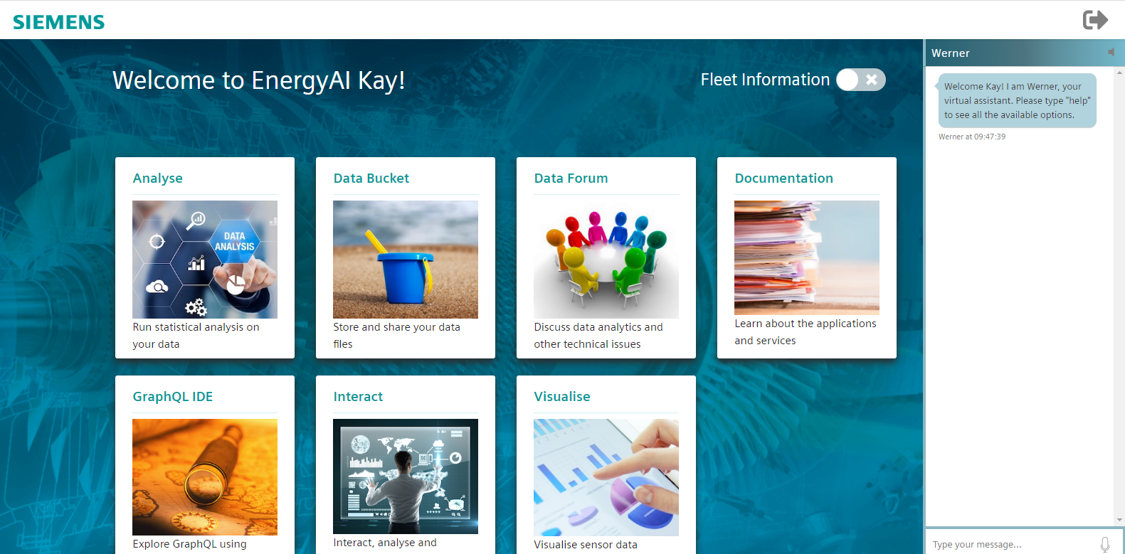
Go to Analyse

Slide 8
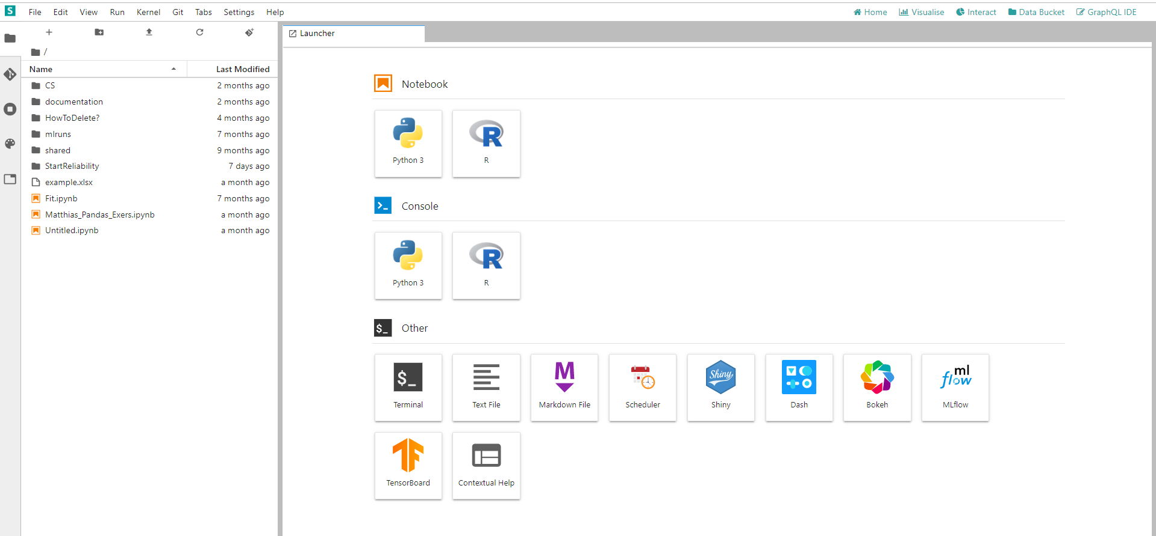
Click on Shared

Slide 9
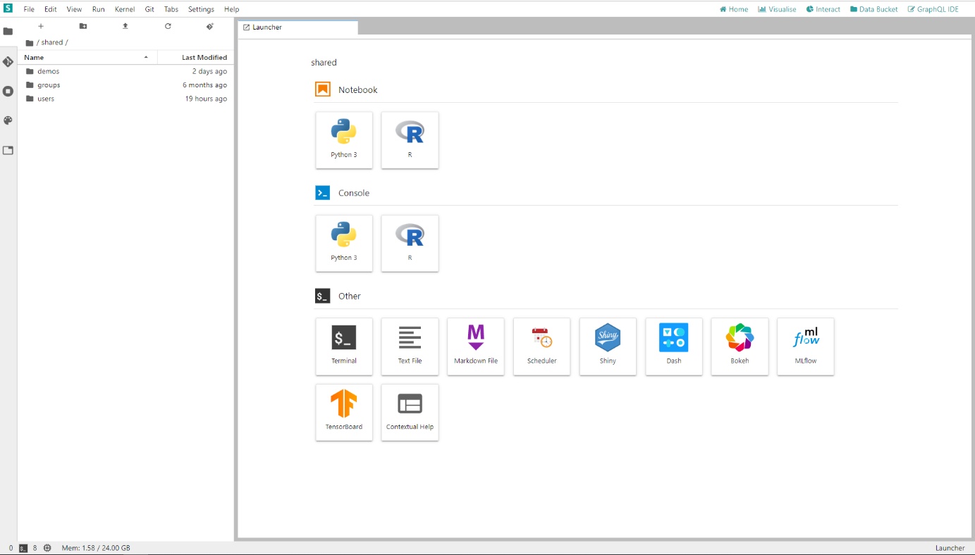
Click on Users

Slide 10
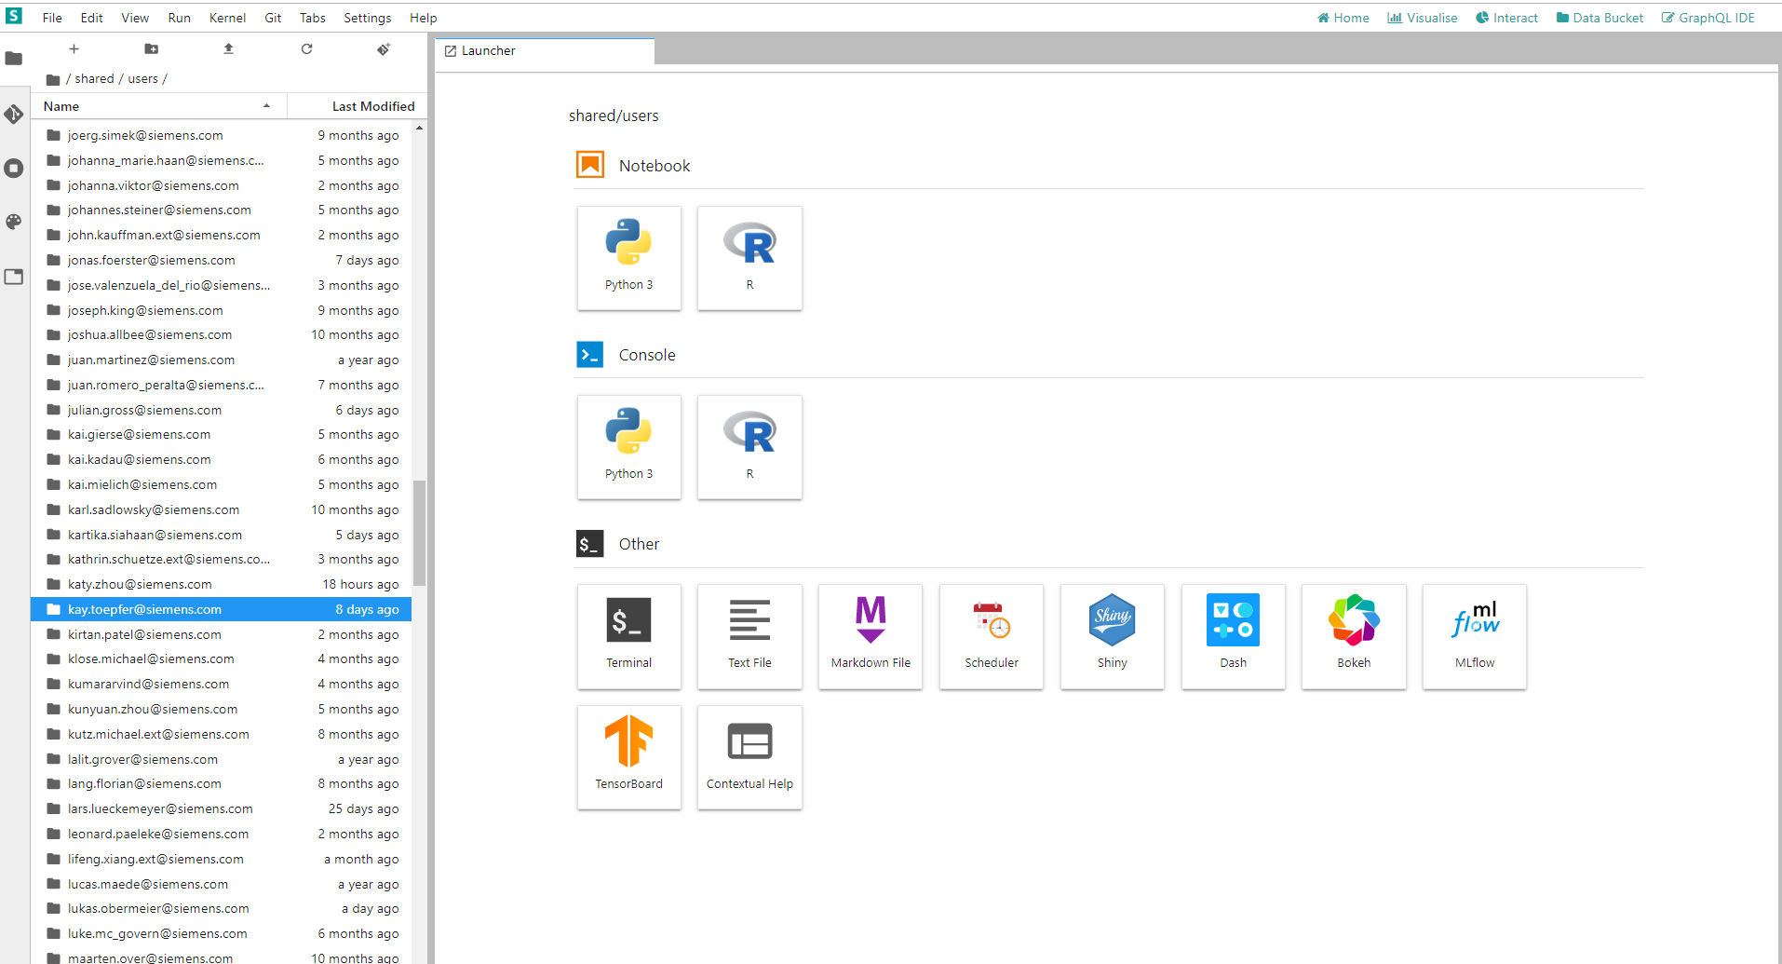
Search for kay.toepfer@siemens.com

Slide 11
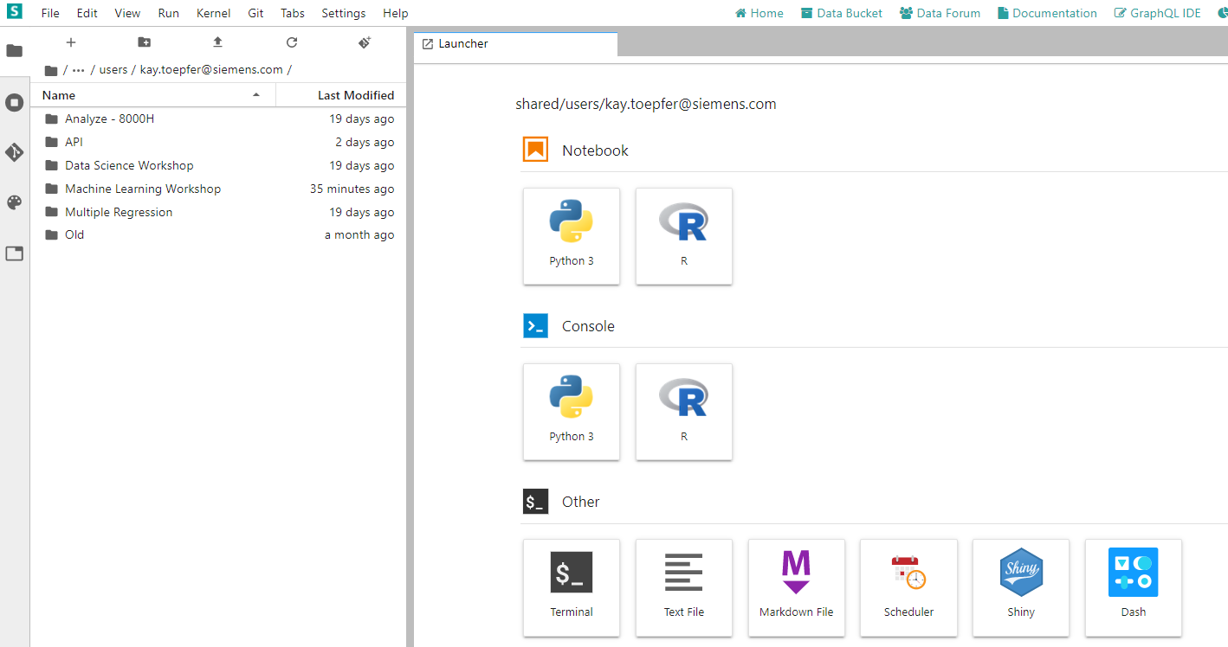
Click on Machine Learning Workshop

Slide 12
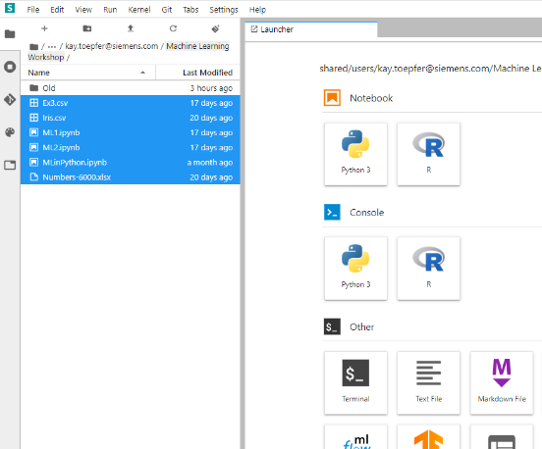
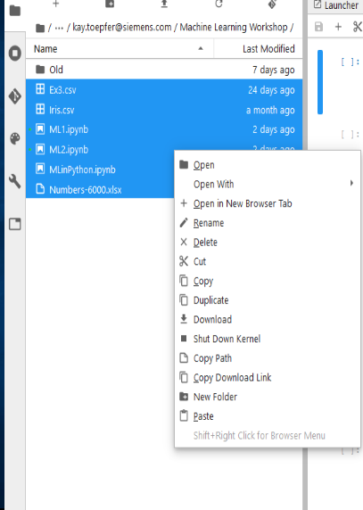
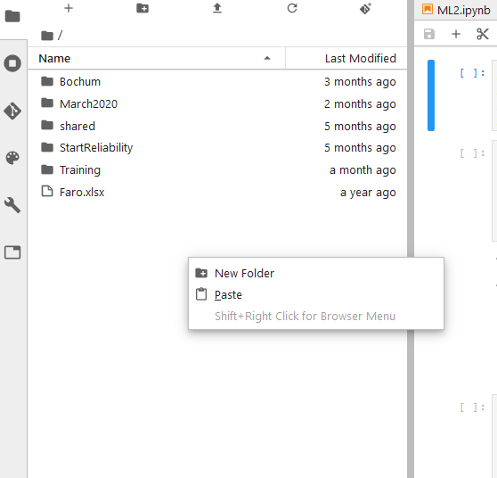
Copy All Files in Your Own Folder
2. Left Click on your folder
1. Right Click on Files -> Copy
3. Right Click -> Paste

Slide 13
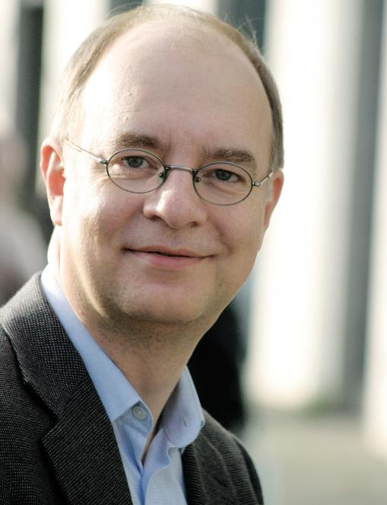
Matthias Groh, Your Instructor
Department “Improvement Projects” of SE Generation Quality
Data Science consultant
Six Sigma Master Black Belt
Previous engagements:
Senior Lean Expert focusing on administration processes @ Siemens Energy Fossil Products, Berlin, Germany
Director Six Sigma @ IIL, New York, NY
Six Sigma Black Belt @ Deutsche Bahn, Frankfurt, Germany
Professional degrees in:
Precision Mechanics
Mathematics
Psychology
If you need help, please contact our support mail box: dataScienceSupport.energy@siemens.com
To contact me personally, email me at groh.matthias@siemens-energy.com
Additional qualifications:
Certified Group Facilitator and Trainer (ABF)
Certified Six Sigma Master Black Belt (IIL)
Certified Project Management Professional (PMI)
Certified Senior Lean Expert (LMI)

Slide 14
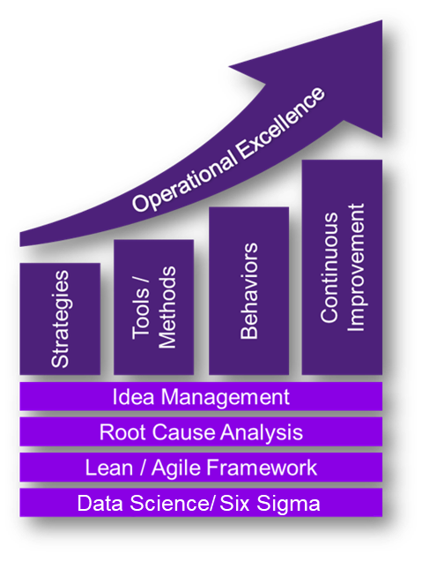


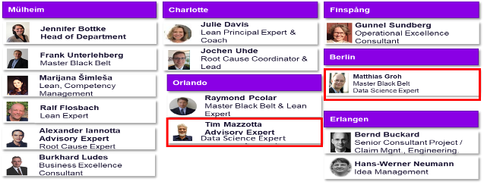
Introduction: Data Science @ SE GP G QPI QM P Improvement Projects
We help your employees getting the skills for the digital future:
Global Data Science Skill Network (with Matt Bryan, LGT R&D)
Data Science and Machine Learning trainings (with several partners):
Currently 11 trainings developed and executed
Attended by >500 participants mostly from R&D
Analytic services in specific improvement projects
EAI CodeShare (with Thomas Buller, LGN R&D)
Data Science @ QPI QM P:
Matthias Groh Master Black Belt
Data Science Expert
Tim Mazzotta Advisory Expert Data Science Expert
Nicolas Schneider
Coop Master Student
Kay Toepfer
Master Student
We help building the bridge between Data Science and daily engineering business.

Slide 15
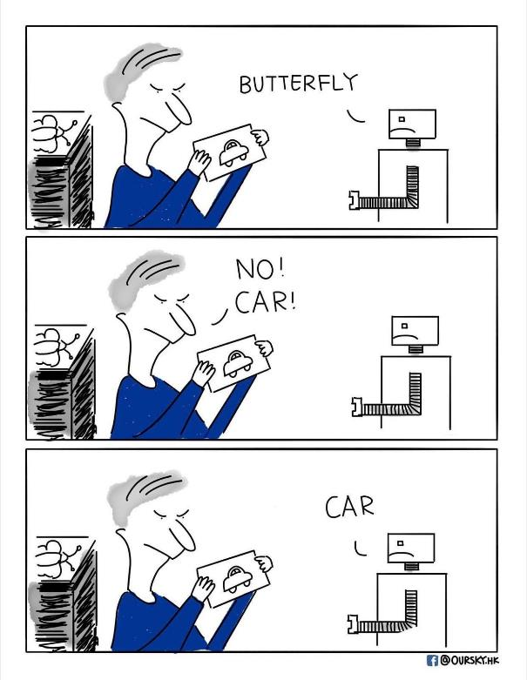
Please Quickly Introduce Yourself
Your name and function / organization
Your background regarding Machine Learning
Which site

Slide 16
Agenda
Introduction
What Is Machine Learning?
Decision Tree Algorithms
Limits of Machine Learning
Neural Networks
Summary: Definitions and Difference between Important Approaches
Application of Machine Learning in Our Business

Slide 17
What is Machine Learning? The First Sentences from Wikipedia …
Machine learning (ML) is the scientific study of algorithms and statistical models that computer systems use to effectively perform a specific task without using explicit instructions, relying on patterns and inference instead. It is seen as a subset of artificial intelligence. Machine learning algorithms build a mathematical model based on sample data, known as "training data", in order to make predictions or decisions without being explicitly programmed to perform the task.
https://en.wikipedia.org/wiki/Machine_learning

Slide 18
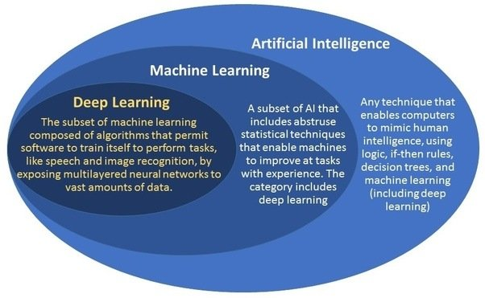
A Trial to Distinguish a bit between Some Key Fields
Our Focus
Notes:
Deep Learning: i.e. Neural Networks with many layers and many neurons. Number of layers from which on Deep Learning ins considered is not specified.

Slide 19


In this Workshop We Will Use a Tool Based on Python and Scikit-learn
Python is an interpreted, high-level, general-purpose programming language, leading in data science.
Scikit-learn is a free and powerful software machine learning library for Python. It is featuring various classification, regression and clustering algorithms

Slide 20
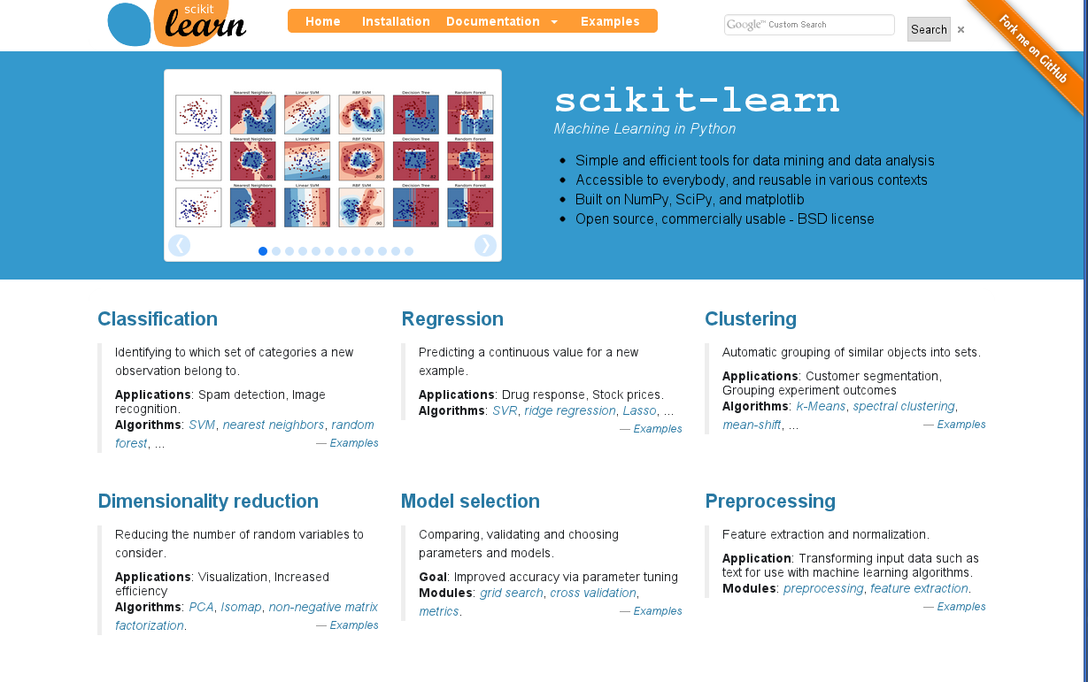
On www.scikit-learn.org There Is Abundant Information on the Complete Library

Slide 21


2 – Learning Types
Supervised Learning
Unsupervised Learning
“Features” (Xs) and “Targets” (Ys)
Example: Start Reliability
Y: Successful ignition / Failure ignition
Only “Features” (Xs)
Example: Amazon Customer analysis
X and Y are known
Exquisite
Preferred Price Class
P-Stage [mbar]
Only X are known
Cheap
D-Stage [mbar]
Purchases / week
Result: Model to predict Y: Y = f (X1, … , Xn)
i.e. for assuring next start is reliable
Result: Clusters to group customers in, i.e. for targeting advertisement
For our business „supervised learning“ is probably the most frequent relevant learning type
Notes:
Reinforcement learning is a third aspect: It needs a value function to work and learns to make decisions based on expected value in the future. That way, it has both exploration and target optimizing aspects in it and mimics the human brain more than supervised and unsupervised learnings. Famous examples are AlphabetZero and AlphabetGo, Googles Chess and Go algorithms. AlphabetZero needed only the chess rules and then 4 hours of learning to beat other leading chess computers.

Slide 22



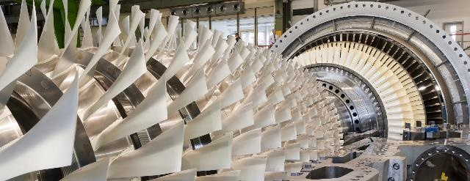
Challenges of Machine Learning Application in Our Business
Consumer Data Analysis
Turbine Data Analysis
Little knowledge about consumer.
Users can be tracked very closely.
Starting from deep understanding -> very difficult to add value on top.
Limited number of engines + change in time, operating conditions, ambient conditions.
ML tools work best when “output data” exists (“supervised” vs. “unsupervised” learning).
We still have to learn together in which situations we can extend our knowledge with ML.

Slide 23

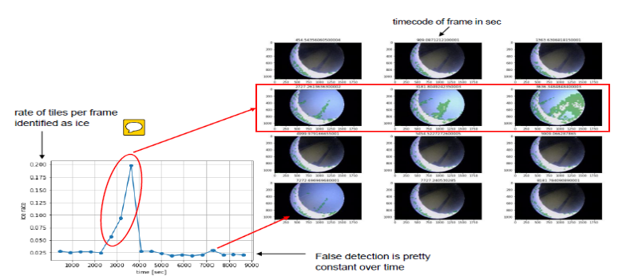
ML Application Example: Compressor Icing Monitoring Lead: Stephan Klumpp
Initial situation & Problem
Approach
During GT Tests installed cameras “see” how much ice occurs on compressor blades
Someone has to watch ours of video
Break up video pictures into tiles: Algorithm analyzes each tile, not entire picture (120 pictures with 42.000 tiles)
Break up tiles into 30x30 pixels
Label a sample manually: do they have ice or not
Build Model with Convolutional Neuro Network
Solution
Benefits
NN Model analyzes the video data and calculates ice rate
Benefits Machine Learning over trad. stat. models
Enable to analyze 900 pixels per tile
Enabled to analyze 42.000 tiles
High accuracy of 90%
Benefits Business
2 Hz picture rate can be analyzed by standard computer in real time
Eliminates engineering hours + frustration
More test hours can be measured -> more data
For more information: contact stephan.klumpp@siemens.com
Notes:
Additional information for presenter:
The white “moon” on the pictures is a thread: the blade is seen very scattered in the middle. See details in notes view.
The system is available but not used as a standard yet.

Slide 24
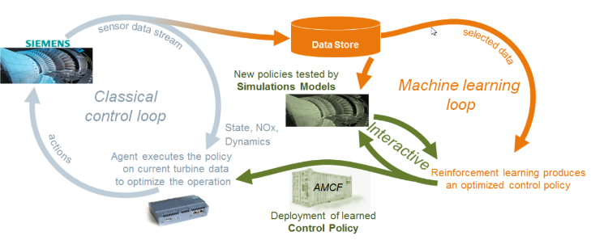
ML Application Example: GT AutoTuner - Emission Module Owners: Katja Rietbrock (Commercial) Sterzing Volkmar (Technology), Gurdev Singh (Technical)
Initial situation & Problem
Approach
GT tuning:
setting amount + gradient of different gas stages in the burner during operation from 70% - baseload
Many input parameters incl. gas quality, ambient weather conditions etc.
Many output variables, incl. emissions (NOx, CO) Vibration of parts, power
Complexity comes from:
Complex fluid dynamics and chemical processes during combustion
Difficult to model during design
Change in ambient conditions
Degradation of parts and hardware upgrades
Sensor noise
Optimization has to be done within short time/ real-time
Tuning needs lots of expert resources without necessarily finding the best optimum.
Studied historical data from the GT fleet
Worked with several algorithms incl. Recurrent NN and Reinforcement Learning
Use of signal processing, numerical as well as T3000 simulator, visualizations, and domain experience
Over 10 years
Solution
Benefits
Provide updates to the traditional T3000 control loop by “Reinforcement Learning” results fused with domain know-how.
Installed in 15 GTs
Better year round control of emissions and dynamics with an average reduction of NOx ~ 10 ppm or higher.
AS3000 platform used for GTAT can be used to host other ML based uses cases in future.
For more information: contact gurdev.x.singh@siemens.com
Notes:
Additional information for presenter:
The white “moon” on the pictures is a thread: the blade is seen very scattered in the middle. See details in notes view.
The system is available but not used as a standard yet.

Slide 25

Having a „Supervised Learning“ Approach, We Should Distinguish between the Different Data Types of the Target Variable
The target variable is Attributive Numerical
40,45
39,97
40,85
38,93
39,12
40,07
success
failure
The learning approach is called:
„Classification“:
Selecting the right group for a new element
„Regression“: Estimates a numerical value for a new element
Most learning algorithms have a version for each,
Classification and Regression
We focus on Classification examples, because they are easier to explain.
Regression follows the same principals.

Slide 26
Agenda
Introduction
What Is Machine Learning?
Decision Tree Algorithms
Limits of Machine Learning
Neural Networks
Summary: Definitions and Difference between Important Approaches
Application of Machine Learning in Our Business

Slide 27
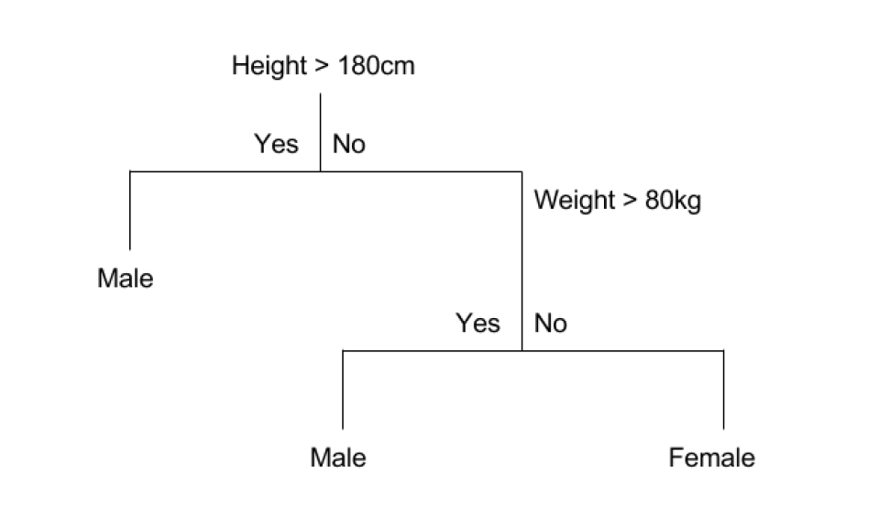
Classification by Decision Trees
New wording CART (Classification and Regression Tree)
A crude example:
Notes:
No learning rate needed. CART select the best split, based on the highest information gain, by splitting between every value for each feature (X). If multiple splits have the same (best) information gain, the CART algo select one split randomly.

Slide 28

Main Idea How a Decision Tree Is Build
Start at the top: first node
Evaluate:
all input variables
all their possible split points
Which would have the highest purity
Split accordingly and generate two leaves
Repeat 2 + 3 with both leaves
Stop when:
Purity can’t be further improved
Some predefined metrics are reached:
Maximal depth (=consecutive branches)→ will play with this
Maximal # of leaves
Notes:
No learning rate needed. CART select the best split, based on the highest information gain, by splitting between every value for each feature (X). If multiple splits have the same (best) information gain, the CART algo select one split randomly.

Slide 29
Purity of a Dataset
PURITY
Entropy is used to measure purity:
Measures actually Impurity
Entropy = 0: perfectly pure node(s)
Entropy >= 1: large mix of males and females
Goes back to the Shannon Entropy in physics
ENTROPY
+
+
+
$$Entropy=1$$
$$Entropy=0.81$$
$$Entropy=0$$
With Decreasing Entropy the Purity Increases.

Slide 30



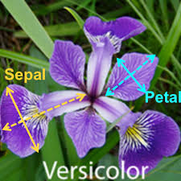
Iris Data Set: 75 Data Points about 3 Types of Irises
21x Iris Setosa 27x Iris Versicolor 27x Iris Virginica
Measured length and width of leaves:
Sepal (dt: Kelchblatt)
Petal (dt. Blüten/ Kronblatt)
X[0]: SepalLengthCm
X[1]: SepalWidthCm
X[2]: PetalLengthCm
X[3]: PetalWidthCm

Slide 31
Plot Your Data!

Slide 32
Training Data and Test Data
Split your data in training and test data:
Training data: to train the model
Test data: to validate if the model works on data the model has not seen yet
X Data
Y Data
Training Data
Iris 1
Setosa
Iris 1
Setosa
Iris 2
Versicolor
Iris 2
Versicolor
Iris 3
Virginica
Iris 3
Virginica
Iris 4
Setosa
Iris 4
Setosa
Test Data
Iris 5
Setosa
Iris 5
Setosa
Iris 6
Virginica
Iris 6
Virginica
Iris 7
Versicolor
Iris 7
Versicolor

Slide 33
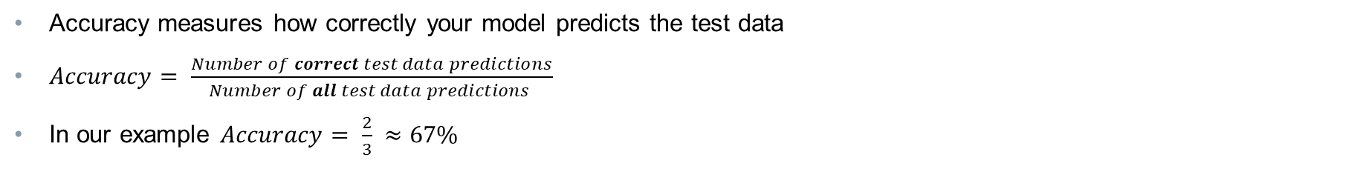
Accuracy of Test Data
Accuracy measures how correctly your model predicts the test data
$Accuracy= \frac{Number of correct test data predictions}{Number of all test data predictions }$
In our example $Accuracy= \frac{2}{3} ≈67\%$
X Data
Y Data
Training Data
Iris 1
Setosa
Iris 1
Setosa
Iris 2
Versicolor
Iris 2
Versicolor
Iris 3
Virginica
Iris 3
Virginica
Iris 4
Setosa
Iris 4
Setosa
Test Data
Test Data Model Prediction
Iris 5
Setosa
Iris 5
Setosa
Iris 5
Setosa
Iris 6
Virginica
Iris 6
Virginica
Iris 6
Versicolor
Iris 7
Versicolor
Iris 7
Versicolor
Iris 7
Versicolor

Slide 34
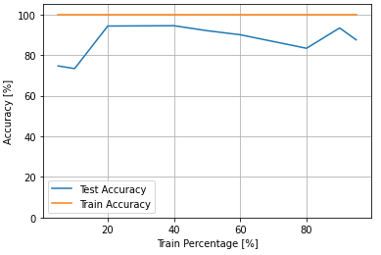
Accuracy of Train Data
Sometimes it‘s useful to see how good the model is on the test and on the train data

Slide 35
How to Jupyter Notebook: Editing Tool for Python
Every box is program code which you can run with shift + enter
There's a symbol in front of each box
[ ] means the cell is not executed
[*] means the cell is executed and the code is running
[3] means that the calculation is completed (continuous numerating of executed boxes)
After running the exercise cells, your results will be saved
If you’ve made a mistake, run the entire notebook again (at least the first 4 lines, then every input / result will be reset)

Slide 36
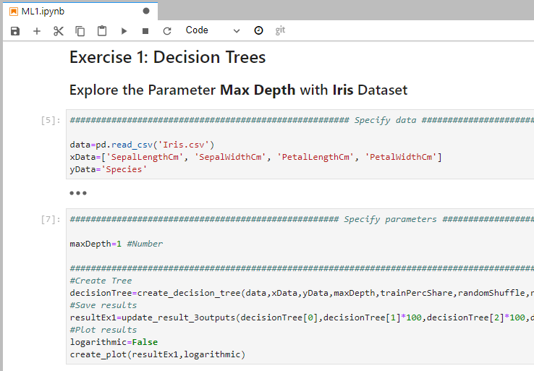
Exercise 1: Explore the Parameter Max Depth
Open the ML1.ipynb Notebook
Run through all cells till Exercise 1: Decision Trees (shift+enter)
Change MaxDepth to 1
Run the cell
Repeat:
with different Max Depth: 1, 2, 3, 4, … 10
Run the cell every time with shift+enter.
Don’t change anything else so that we can compare.
Consider the change in the accuracy of training and test data sets and the entropy for different maximum depths.
5. Compare accuracy of training and test data sets. Which difference do you see?
6. Run the next two cells (till show_trees(resultEx1) ) and have a look at the trees. What development of entropy, accuracy do you see?

Slide 37
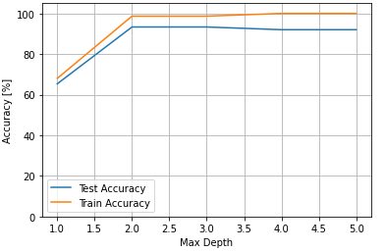
Explore the Parameter Max Depth
At the beginning the accuracy increases with increasing max depth
For max depth > 2 the accuracy don’t change very much
-

Slide 38
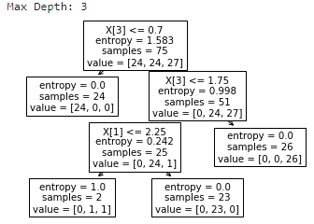
Explore the Parameter Max Depth
Entropy decreases for “purer” nodes
-

Slide 39
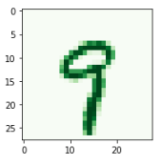
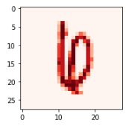
Example 2: Number Recognition
X-Variables: 28x28 = 784 variables with pixel data
X-Range: 0-255 for intensity of the pixel
Y-Variable: correct number: 0, 1, …., 9
Numbers (700): 630 training data + 70 test data
Easy to identify:
Hard to identify:

Slide 40
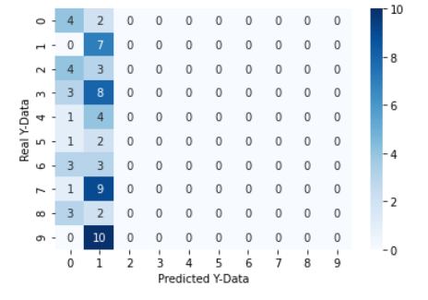
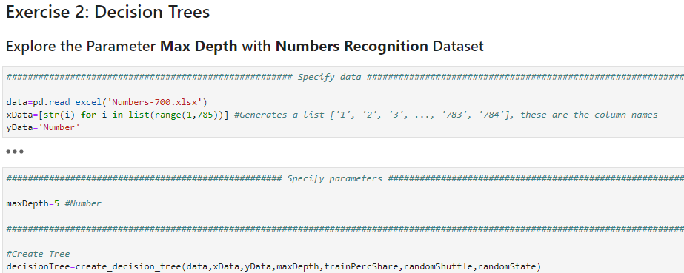
Exercise 2: Numbers Recognition Find the Optimal Tree Depth
This head chart shows you what happens with the test data when you apply the model:
Go to Exercise 2: Decision Trees
Perform decision tree with different Max Depth (1 – 20) and find the optimal depth
What else the optimal depth?
What else do you observe?
Counts of Predictions
Diagonal = correct predictions

Slide 41
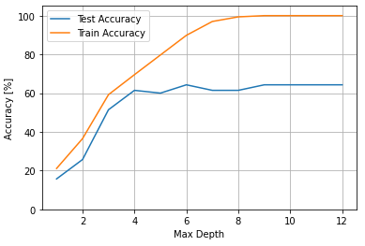
Exercise 2: Number Recognition Using Decision Tree
Optimal max depth around 6
Overfitting
Over- and underfitting will be explained in the next section.
Optimal fit
Underfitting
For more information go to: https://scikit-learn.org/stable/modules/generated/sklearn.tree.DecisionTreeClassifier.html#sklearn.tree.DecisionTreeClassifier

Slide 42
Agenda
Introduction
What Is Machine Learning?
Decision Tree Algorithms
Limits of Machine Learning
Neural Networks
Summary: Definitions and Difference between Important Approaches
Application of Machine Learning in Our Business

Slide 43
Model Limitations
Error Type
Summary
Details
How to prevent it
Model Error
Bias Error/ Underfitting
Model is too simple
The (unknown) true target function is more complex than the model.
Review with domain experts
More complex analysis
Variance Error/ Overfitting
Modell is too complex
The true target function is simpler than the model. Common reason: model tries to explain randomness
Review with domain experts
Split data in training and test data
Talk to data scientist
Any build model build is an approximation of a true target function and therefore includes errors.

Slide 44
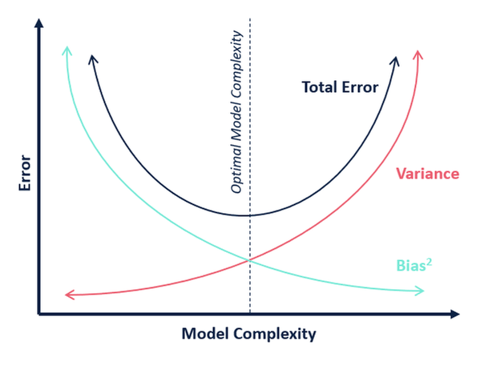
Bias-Variance Trade-Off
Occam‘s razor: The simplest model/most intuitive method is preferable
Notes:
William of Ockham, a Franciscan friar who studied logic in the 14th century, first made this principle well known.^{[1]}
William of Ockham wrote “More things should not be used than are necessary.”
This means if there are several possible ways something might have happened, the way which uses the fewest guesses is probably the correct one. However, Occam's razor only applies when the simple explanation and complex explanation both work equally well. If a more complex explanation does a better job than a simpler one, then you should use the complex explanation.
https://simple.wikipedia.org/wiki/Occam%27s_razor

Slide 45
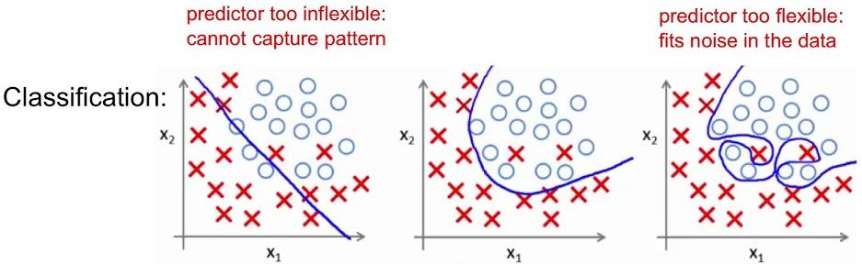
Model Selection: Under- and Overfitting for Numerical and Attribute Target Variables
Review results from Exercise 2 Number Recognition using Decision Tree:

Slide 46
Agenda
Introduction
What Is Machine Learning?
Decision Tree Algorithms
Limits of Machine Learning
Neural Networks
Summary: Definitions and Difference between Important Approaches
Application of Machine Learning in Our Business

Slide 47
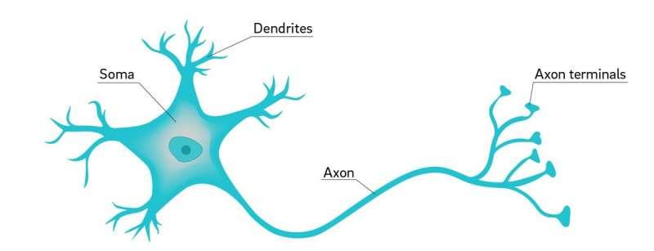

Artificial Neural Nets (ANN) Are Highly Complex Models Inspired by the Biological Neural Networks that Constitute Brains
With just ~100.000 neurons a fruit fly brain can:
Fly
Find food
Realize and avoid danger
…
All our computers have much more calculation capacity than 100.000 neurons
Why is it hard for computer to do what a fruit fly can?
Notes:
Dendriten: nehmen Reize auf und leiten diese zum Soma weiter
Soma: Zellkörper, der sogenannte Axonhügel und den Zellkern enthält
Axonhügel: Postsynaptische Signale addieren sich auf, Erregung wird aber nur weitergeleitet, wenn ein gewisser Schwellenwert überschritten wird → nicht alle Signale/Reize werden aufgenommen (würde uns überfordern und höchstwahrscheinlich zum Tode führen)
Axon: langer Nervenzellfortsatz, der die elektrischen Reize vom Soma zur nächsten Nervenzelle weitergibt
Synaptische Endköpfchen/Synapsen: am Ende des Axoms befinden sich die snyaptischen Endköpfe, welche mit Hilfe des übertragenen Spannungspotenials eine chemische Reaktion auslösen → Neurotransmitter werden im synaptischen Spalt freigesetzt und dieses chemische Signal wird wieder in ein elektrisches Signal umgewandelt und an die nächsten Dendriten weitergegeben.
Menschliche Gehirn enthält circa 1 Billion (1 mit 12 Nullen) Neuronen

Slide 48
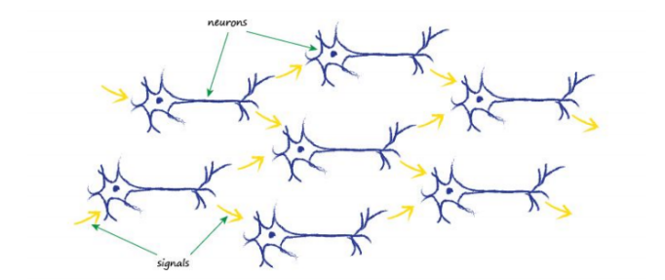
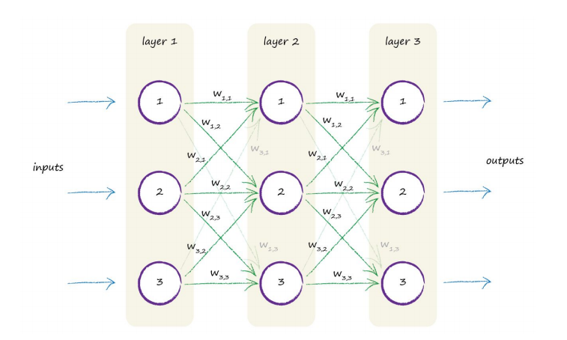
Neural Networks Take Key Inspirations from Biological Brains: 1. Take Many Inputs
Biological brain
Neurons = Variable:
Inputs
Outputs
Artificial Variables in between
Connect each neuron with all neurons to previous and next layer
Weight the connections between neurons:
Weight = slope between two variables in linear relationship
adjust the strength of the connections between neurons
Neural
Network
Adapted from: Tariq Rashid “ Make Your Own Neural Network”

Slide 49
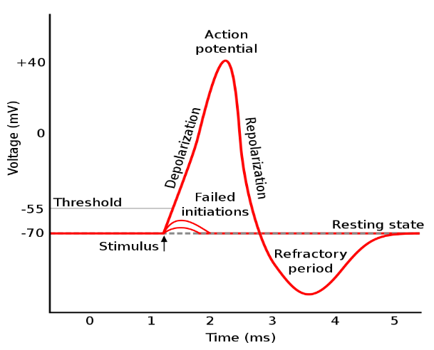
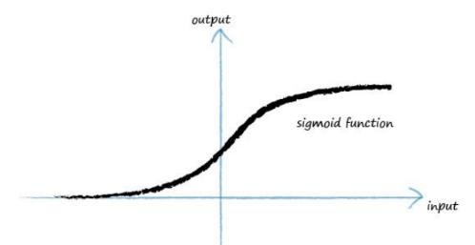
Neural Networks Take Key Inspirations from Biological Brains: 2. Use Activation Function to Differentiate btw. Important and Unimportant Inputs
Neurons work with a threshold:
Large inputs -> output
Small input -> no output change
Computer use instead a “Activation Function”
Not dealing with time
But weighting input e.g. Sigmoid function:
Small changes in small or large inputs → small output change
Small changes in inputs near 0 → large output change
(a.n.a. Logistic function)
https://en.wikipedia.org/wiki/Action_potential
Adapted from: Tariq Rashid “ Make Your Own Neural Network”
Notes:
Derivative: abgeleiteter Wert, for backpropagation
Disadvantage: problem of lost gradient, for little and large x y has very flat slope. Learning is very slow or stops

Slide 50
Neural Networks Take Key Inspirations from Biological Brains: 3. Adjust model for each new data point slightly
Inference Statistics calculates a model from all data points at once
Neural Networks start with random parameters
Next they adjust the parameter for each new data point.
Starts with a random line
1
Leg Length
4
Leg Length
3
3
2
5
Each time move line towards the next data point
4
1
5
Errors get minimized
2
Body Hight
Body Hight
Neural Networks are much too complex to calculate them at once.

Slide 51
Neural Networks Take Key Inspirations from Biological Brains: 3. Adjust model for each new data point slightly
Inference Statistics calculates a model from all data points at once
Neural Networks with random parameters
Next they adjust the parameter for each new data point.
Example: The slope of a linear relationship
Starts with a random line
1
Leg Length
Leg Length
3
Each time move line towards the next data point
4
1
5
Errors get minimized
2
Body Hight
Body Hight

Slide 52
Neural Networks Take Key Inspirations from Biological Brains: 3. Adjust model for each new data point slightly
Inference Statistics calculates a model from all data points at once
Neural Networks start with random parameters
Next they adjust the parameter for each new data point.
1
Leg Length
Leg Length
3
2
4
For each observation move line a bit towards the data point
1
5
Errors get minimized
2
Body Hight
Body Hight

Slide 53
Neural Networks Take Key Inspirations from Biological Brains: 3. Adjust model for each new data point slightly
Inference Statistics calculates a model from all data points at once
Neural Networks start with random parameters
Next they adjust the parameter for each new data point.
Leg Length
Leg Length
3
3
2
Each time move line towards the next data point
4
1
5
Errors get minimized
2
Body Hight
Body Hight

Slide 54
Neural Networks Take Key Inspirations from Biological Brains: 3. Adjust model for each new data point slightly
Inference Statistics calculates a model from all data points at once
Neural Networks start with random parameters
Next they adjust the parameter for each new data point.
Leg Length
4
Leg Length
3
3
Each time move line towards the next data point
4
1
5
Errors get minimized
2
Body Hight
Body Hight
Machine Learning never moves 100% onto the new data point. Why?

Slide 55
Neural Networks Take Key Inspirations from Biological Brains: 3. Adjust model for each new data point slightly
Inference Statistics calculates a model from all data points at once
Neural Networks start with random parameters
Next they adjust the parameter for each new data point.
Leg Length
4
Leg Length
3
5
Each time move line towards the next data point
4
1
5
Errors get minimized
2
Body Hight
Body Hight
Machine Learning never moves 100% onto the new data point. Why?

Slide 56
Why Does Machine Learning Never Move 100% onto the New Data Point?
Usually, data is noisy
Measuring errors
Not measured factors impacting outcome
…
If we would fit data to 100% to the new data point, we would:
Model jumps a lot with each data point
Last training data point determine the entire result
Model explains not just real effect but also noise of last training point
Neural Network Approach
Wrong Approach: Fit Point 100%
Trad. Inference Stats. Approach
Leg Length
4
Leg Length
4
Leg Length
3
3
4
☑
5
4
5
☑
Move line towards next data point
Fit data point 100%: last point would determine model 100%
1
5
1
5
Errors get minimized
2
2
Body Hight
Body Hight
Body Hight

Slide 57
The Learning Rate (LR)
Factor between 0 and 100%
Determines how much the line moves to the next data point
Dampens effect of the last data, errors and noise
Formula: Move = Learning Rate x Distance / 100%
For big data (> Mill) often: LR< 0.001%
Starting Point
LR=25%
Leg Length
LR=50%
LR=100%
Body Hight
LR = How much should we move the line based on the next data point

Slide 58
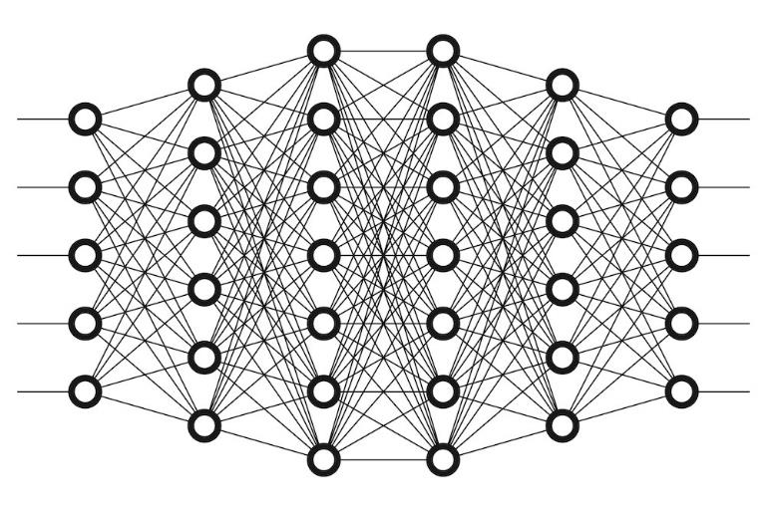
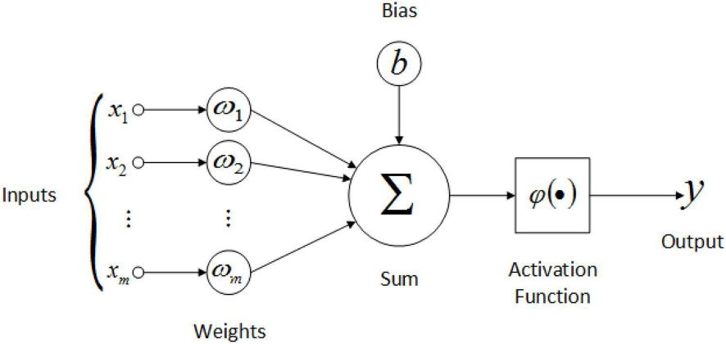
Analogies between Human and Artificial Neural Nets
‚Dendrites‘
‚Neurons‘
‚Axon‘
Input layer
Hidden layers (example: 4 layers)
Output layer

Slide 59
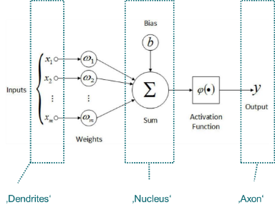
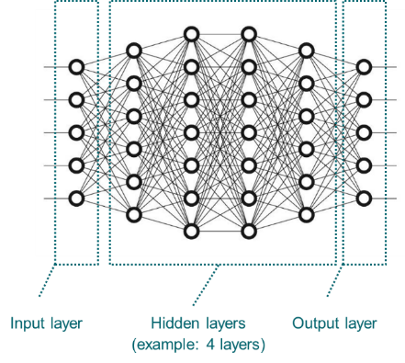
Basic Steps of Training a Neural Network
Select first element from the training data set
Start with random weights (some restrictions apply) ->NN₁
Calculate predicted output based on first element and those weights
Calculate Error distribute to weights
Recalculate weights based on error -> NN₂
Repeat step 2-4 with all elements from the training data set
Iterate through all data several times (steps a) and b)) until weights converge to one value
Traditional Regression Analysis would calculate all weights based on all sample data at once.

Slide 60
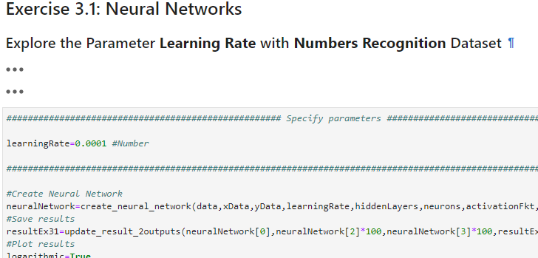
Exercise 3: Number Recognition Using Neural Network
Go to Exercise 3.1: Neural Networks
Find the best learning rate
Optional
Go to Exercise 3.2 and find for the best learning rate the best number of hidden layers

Slide 61
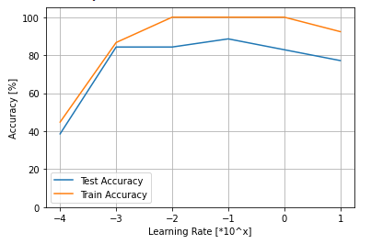
Exercise 3: Number Recognition Using Neural Network
Best learning rate at ~0.1 ?

Slide 62
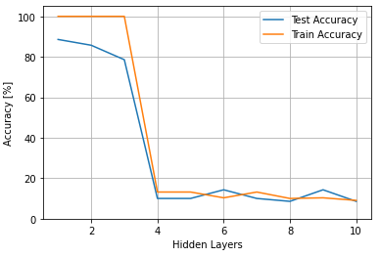
Exercise 3 Optional: Number Recognition Using Neural Network
If you increase the number of hidden layers, the model deteriorates.
Learning rate = 0.1
For more information go to: https://scikit-learn.org/stable/modules/generated/sklearn.neural_network.MLPClassifier.html#sklearn.neural_network.MLPClassifier

Slide 63
Agenda
Introduction
What Is Machine Learning?
Decision Tree Algorithms
Limits of Machine Learning
Neural Networks
Summary: Definitions and Difference between Important Approaches
Application of Machine Learning in Our Business

Slide 64

Cloud Computing
Data storage and processing in a flexible cloud rather then defined set of individual computers
Users send just commands and receive results via internet
Cloud provides space and calculation power on demand
Enables processing of unpreceded amount of data
Example: powerplant data on Amazon Web Services: EnergyAI or Mosaic

Slide 65
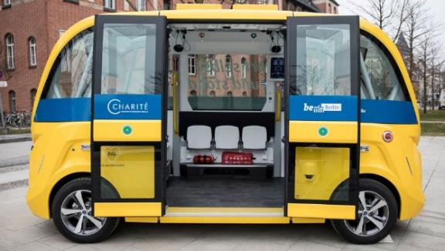
Artificial Intelligence (AI)
Anything to make computers mimic human behavior
Includes rule based programming and machine learning
Talked about ever since computers were invented
Content changes with fashion/ progress
Example: Autonomous driving bus at Berlin Hospital “Charite”
https://towardsdatascience.com/the-actual-difference-between-statistics-and-machine-learning-64b49f07ea3#:~:text=%E2%80%9CThe%20major%20difference%20between%20machine,about%20the%20relationships%20between%20variables.%E2%80%9D&text=Statistics%20is%20the%20mathematical%20study%20of%20data…
https://www.ibm.com/cloud/blog/ai-vs-machine-learning-vs-deep-learning-vs-neural-networks

Slide 66
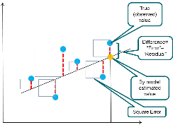
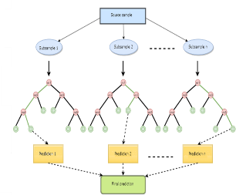
Machine Learning vs. Conventional Statistical Models
Machine Learning
Goal:
make the most accurate predictions possible
Approach:
Separate data in train and test data
Train the model using training data
Evaluate model using test data
Aspects:
Model’s predictions can often not be explained step by step (‘Black Box’)
Often designed to process large data sets (big data)
Conventional Stats Modelling
Goals (depending on situation of different weight):
infer something about the relationships within the data
Stable model parameters
be able to predict future values
Approach:
Build model using all data
Evaluate several aspects of the model
Aspects:
Models predictions can usually be explained step by step (no ‘Black Box’)
Can often handle less data as ML
Both approaches allow computers to improve through experience and to act without explicit problem-oriented programming.
Source: https://towardsdatascience.com/the-actual-difference-between-statistics-and-machine-learning-64b49f07ea3#:~:text=%E2%80%9CThe%20major%20difference%20between%20machine,about%20the%20relationships%20between%20variables.%E2%80%9D&text=Statistics%20is%20the%20mathematical%20study%20of%20data.
…

Slide 67
(Artificial) Neural Networks (NN, Part of ML):
Mimics human brains
Inputs and Outputs are connected by “Hidden Layers”
Hidden Layers consist of “Neurons”: little calculation models adding up inputs to an output
Calculations take many or all inputs into account
“Activation function” prioritizes output of each neuron
Adopting NN by each data point, not calculating all weights at once
Deep Learning:
NN with more than one hidden layer
Examples: Speech and picture recognition

Slide 68
There is a lot of overlap between these concepts:
Data Science
Data Preparation + Data Exploration
Convent. Statistical Modelling
Artificial
Intelligence
Cloud
Computing
Machine Learning
Neural Netw./ Deep Learning

Slide 69
Agenda
Introduction
What Is Machine Learning?
Decision Tree Algorithms
Limits of Machine Learning
Neural Networks
Summary: Definitions and Difference between Important Approaches
Application of Machine Learning in Our Business

Slide 70
Challenges of Machine Learning Application in Our Business (Review)
Consumer Data Analysis
Turbine Data Analysis
Little knowledge about consumer.
Users can be tracked very closely.
Starting from deep understanding -> very difficult to add value on top.
Limited number of engines + change in time, operating conditions, ambient conditions.
ML tools work best when “output data” exists (“supervised” vs. “unsupervised” learning).
We still have to learn together in which situations we can extend our knowledge with ML.

Slide 71
Data Science Is an Iterative Process.
Tech. Domain Knowledge
Data Mapping
Scripting (Python i.e.)
Script Debugging
Data Cleaning
Conducting convention. Statistic
Running + interpreting ML
Problem stating
Hypotheses stating
For field issues differentiate between fast application and foundational development.

Slide 72
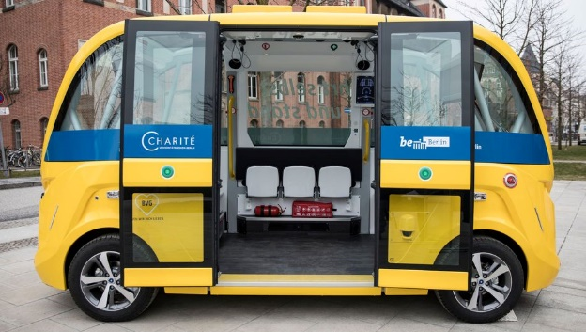

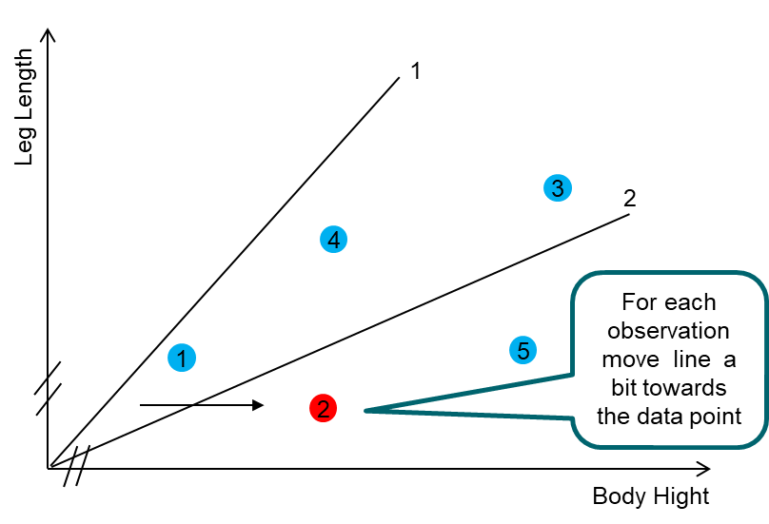
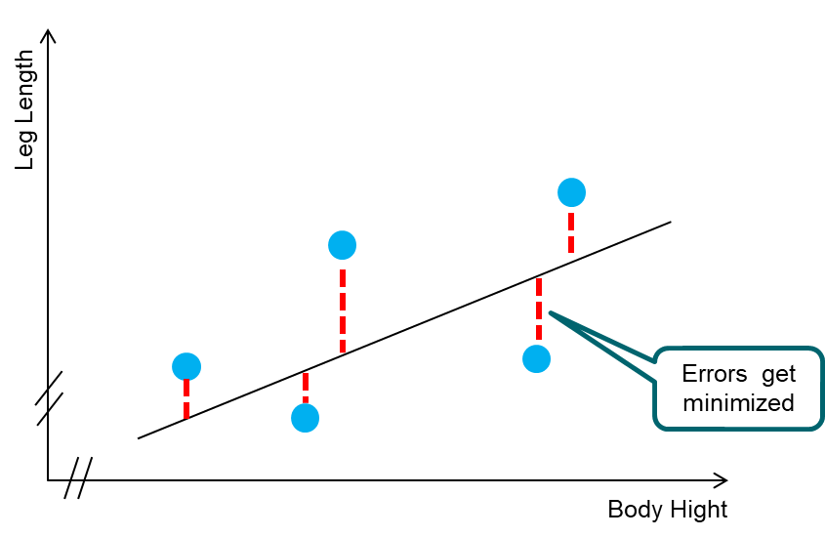
Overview of some Digitalization Tools and Terms
Artificial Intelligence (AI):
Anything to make computers mimic human behavior
Includes rule based programming and machine learning
Talked about ever since computers were invented
Content changes with fashion/ progress
Example: Autonomous driving
Cloud Computing:
Data storage and processing in a flexible cloud rather then defined set of individual computers
Users send just commands and receive results via internet
cloud provides space and calculation power on demand
Enables processing of unpreceded amount of data
Example: powerplant data on Amazon Web Services: EnergyAI or Mosaic
Machine Learning (ML, Part of AI):
A system that allows computers to improve through experience
Adjusts computer model through each additional data point
Can process larger data sets than classical inference statics
ML’s predictions/ decisions can often not be explained step by step (‘Black Box’)
Examples: Weather forecast
(Artificial) Neural Networks (NN, Part of ML):
Mimics human brains
Inputs and Outputs are connected by “Hidden Layers”
Hidden Layers consist of “Neurons”: little calculation models adding up inputs to an output
Calculations take many or all inputs into account
“Activation function” prioritizes output of each neuron
Deep Learning: NN with more than one hidden layer
Examples: Speech and picture recognition
Classical Inference Statistics:
Makes predictions based on data
Models are calculated at once based on all data
Updating a model with new experience requires to recalculate the entire model (-> can not handle as much data as ML)
Models predictions/ decisions can usually be explained step by step (no ‘Black Box’ as often in ML)
Example: Conventional prediction of Nox-Emissions
Sources include: https://pub.towardsai.net/differences-between-ai-and-machine-learning-and-why-it-matters-1255b182fc6
https://www.ibm.com/cloud/blog/ai-vs-machine-learning-vs-deep-learning-vs-neural-networks
Notes:
https://www.ibm.com/cloud/blog/ai-vs-machine-learning-vs-deep-learning-vs-neural-networks

Slide 73

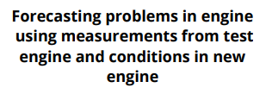




















What Could Be an Application in Your Business?

Slide 74
Please Give Us Feedback!
Feedback is very important for us. This course is free, but we need to know if this is beneficial for you.
Based on your feedback, we will continue to offer this, develop additional courses – or not.
Please visit at the end of this course the following website: https://forms.office.com/Pages/ResponsePage.aspx?id=PqlLJW8f80iQ5uJ2ZmS0d-5LdjYRShZEhN3YmsD7St9UMFZZTFFVQjFSUUxTMzhQNTM3S1hSM0ExVS4u

